Slide 1

Data Quality Task Group 3 – Use Case Library Miles Nicholls Data Manager, Atlas of Living Australia

Slide 2
Task Group Purpose
The third task group of the GBIF TDWG biodiversity data quality interest group
Tasked to assemble a library of use cases describing specific examples of data selection

Slide 3
Activities
Use the framework from TG1 to develop a use case description store – a series of related worksheets to capture a use case.
From this point it has been a process of iterating over use case description mechanisms to try and reach a usable tool:

Slide 4
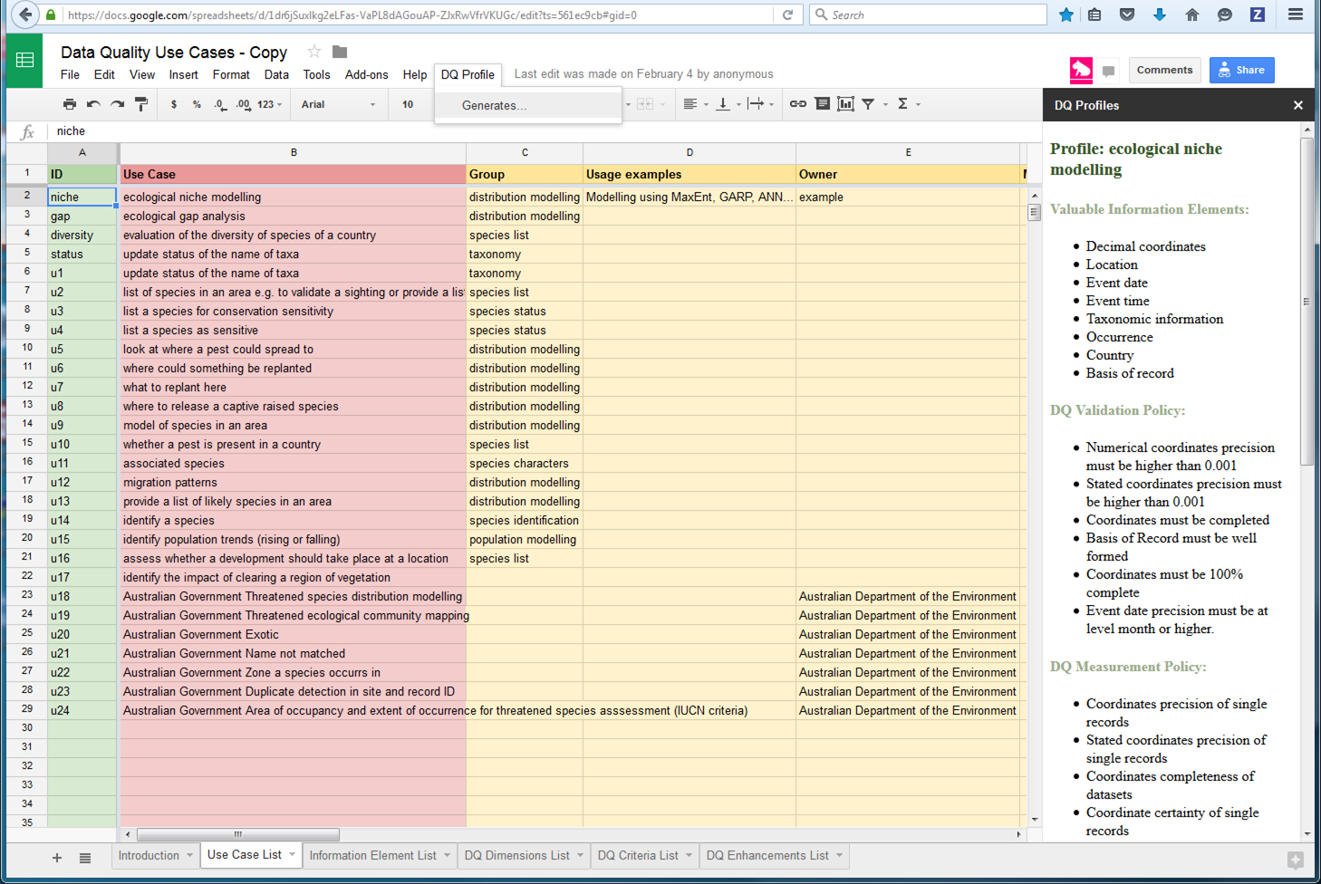
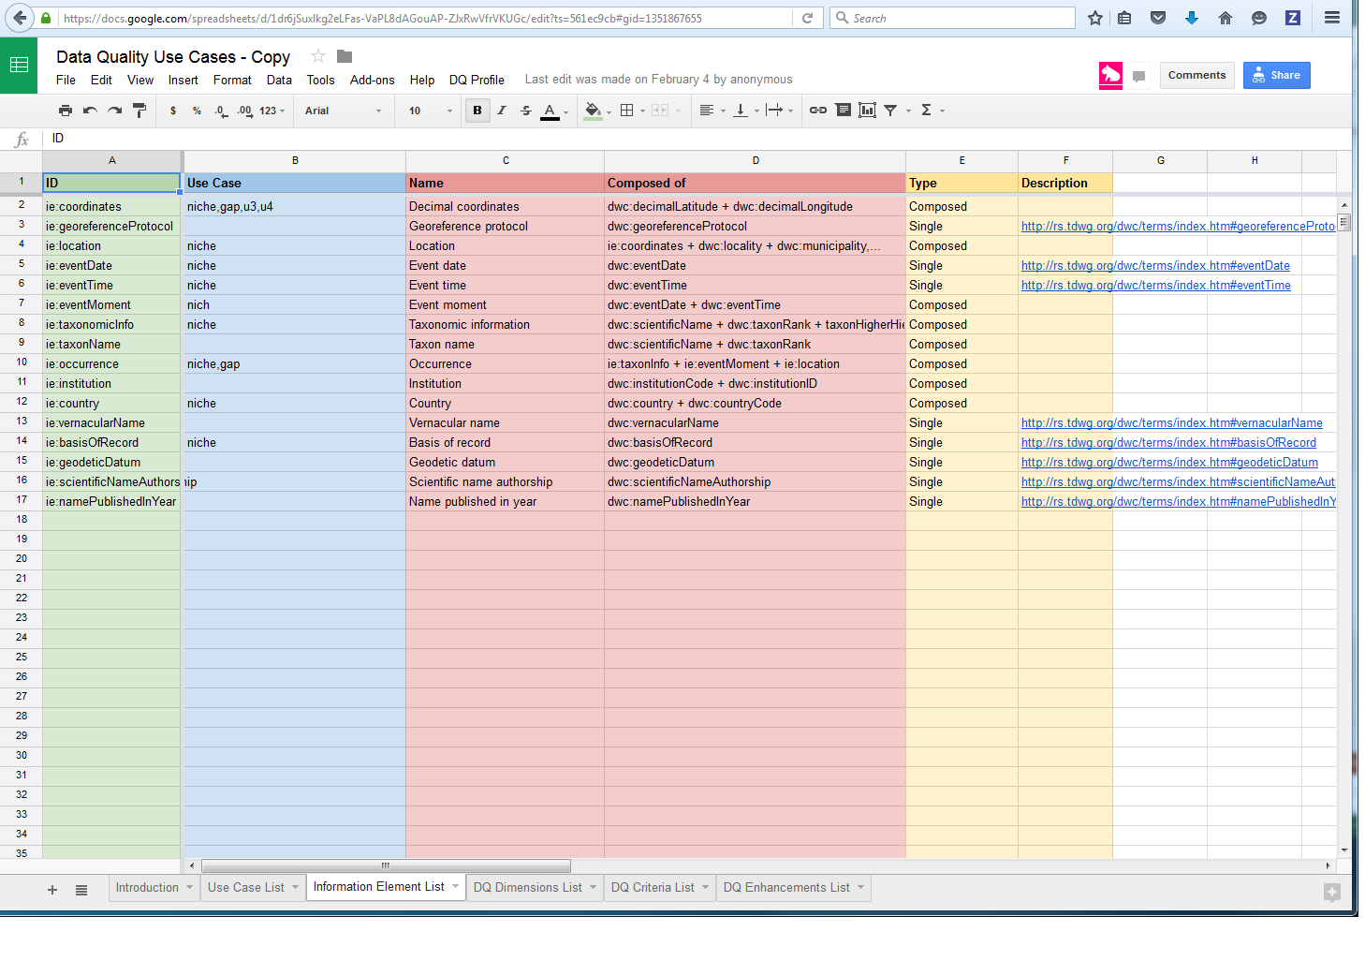
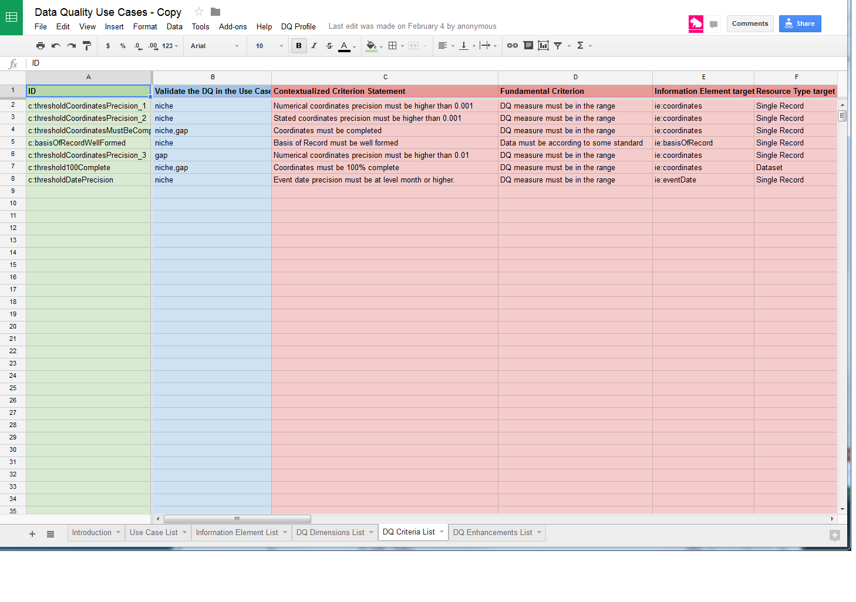
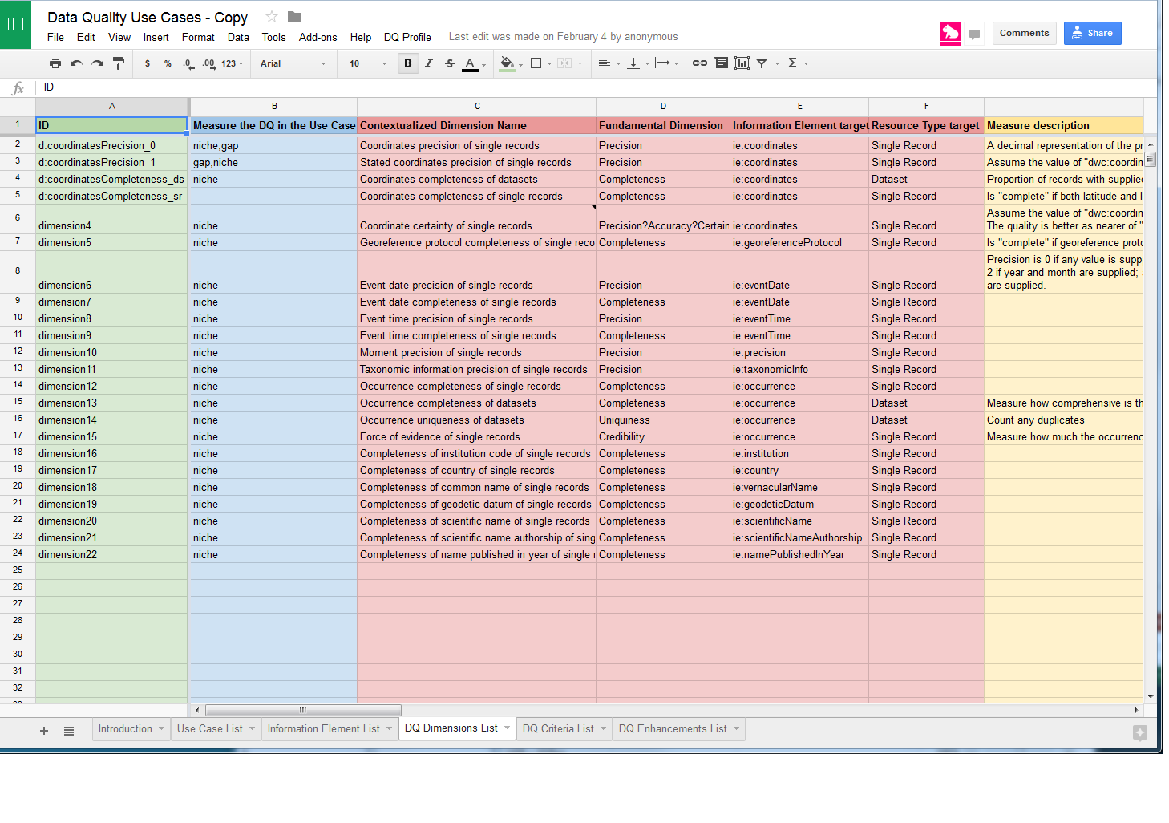
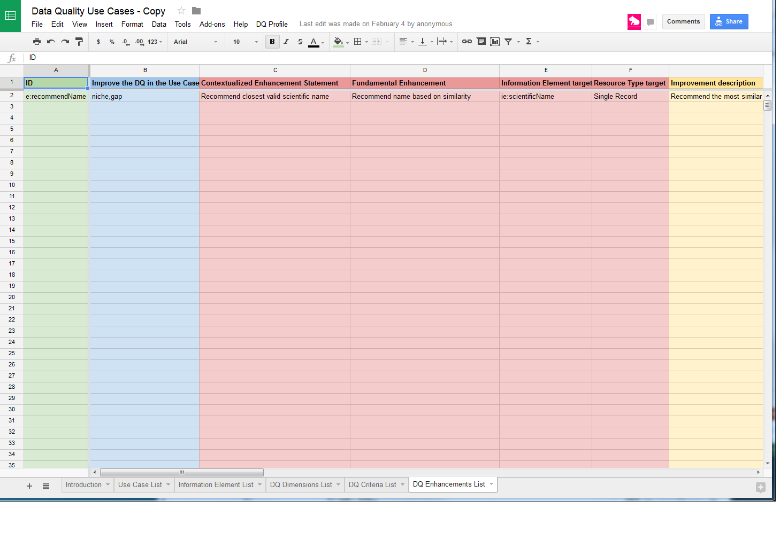
Use case description store
https://docs.google.com/spreadsheets/d/1dr6jSuxlkg2eLFas-VaPL8dAGouAP-ZJxRwVfrVKUGc/edit?ts=561ec9cb#gid=0

Slide 5
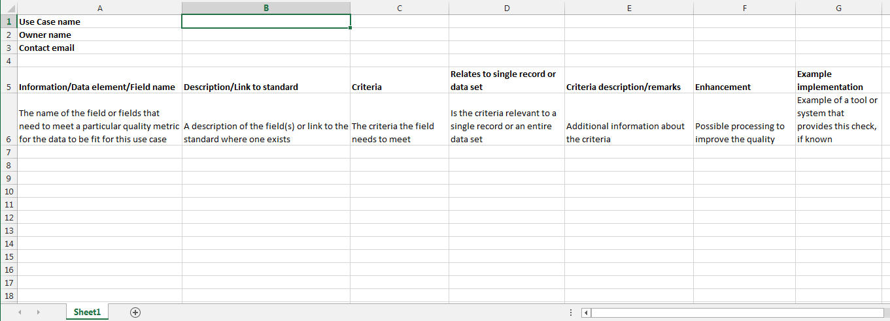
Offline worksheet

Slide 6
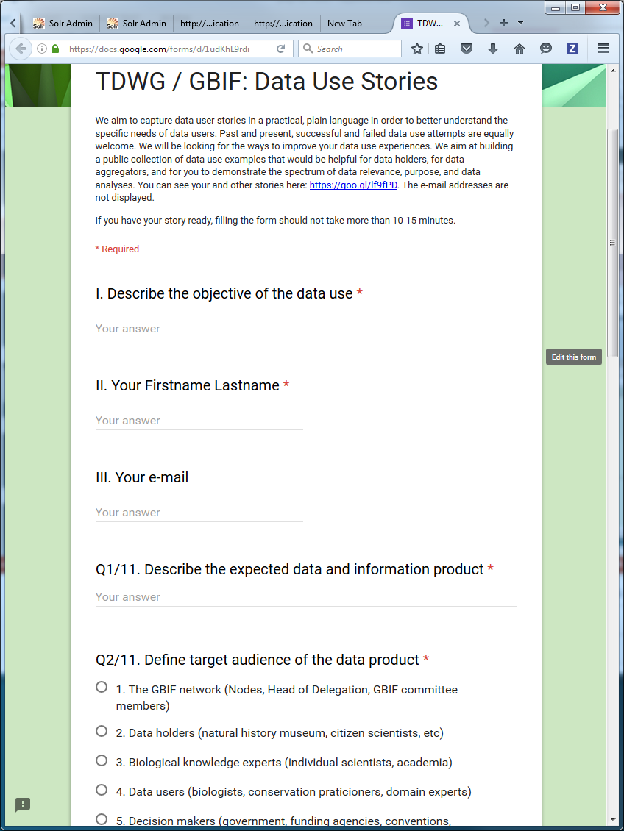
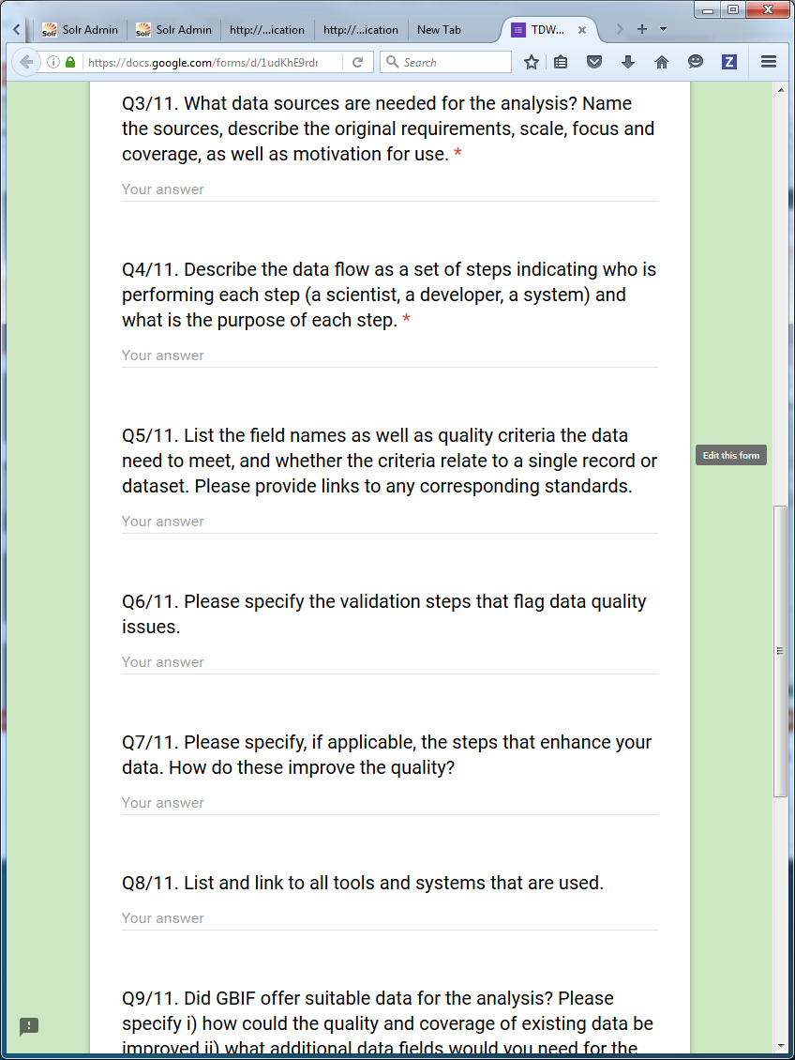
Google form
https://docs.google.com/forms/d/1udKhE9rdr2txkDE8MiBK-wHHVbr4G5mcdktq6P3rFXk/viewform

Slide 7
Why collect use cases
To build a use case library as a resource to research how data is selected for particular purposes
Allow reuse of use cases for consistent quality assessment
To build profiles of the most used information elements, dimensions and criteria and feed these back into the development of data capture and quality assessment tools
Begin to develop automated data selection for use cases

Slide 8
Contribute a Use Case
Do you have a data quality use case?
Search for “data quality interest group”
Task Group 3 - Use Case Library for Data Quality
TDWG / GBIF: Data Use Stories

Slide 9
Thank you
Miles.Nicholls@csiro.au

